Slide 1
naming things
coding standards

Slide 2
naming things
based on a presentation
by Jenny Bryan
for Reproducible Science Workshop

Slide 3
names matter

Slide 4
you can name your files whatever you want

Slide 5
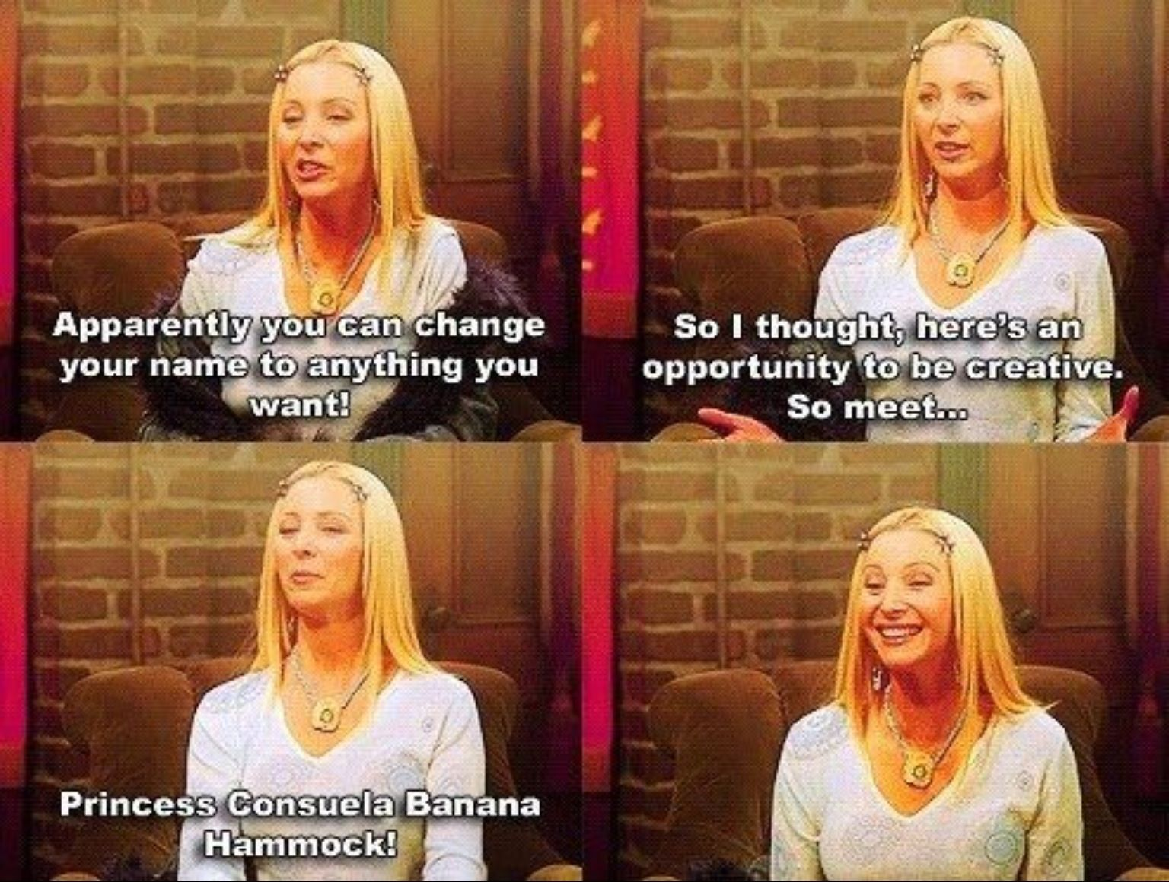
but that doesn’t mean you should
but “Why?”
asked every five-year old ever

Slide 6
because the larger context
you're not in this alone
It's dangerous to go alone!
we‘re doing the team science
and what you do impacts your team
or your kid if you name them X Æ A-12

Slide 7


you → naming the files after your favorite band’s discography…
This DSPG Project
is Metal!
Infernus Ad Astra.docx
Rise of the Chaos Wizards.png
Legend of the Astral Hammer.png
Goblin King of the Darkstorm Galaxy.xl
The Hollywood Hootsman.docx
Victorious Eagle Warfare.sav
Questlords of Inverness, Ride to the Galactic Fortress!.txt
Universe on Fire.txt
Heroes (of Dundee).txt

Slide 8

the rest of your team →
discovering that you named the files after your favorite band’s discography
This DSPG Project
is Metal!
Infernus Ad Astra.docx
Rise of the Chaos Wizards.png
Legend of the Astral Hammer.png
Goblin King of the Darkstorm Galaxy.xl
The Hollywood Hootsman.docx
Victorious Eagle Warfare.sav
Questlords of Inverness, Ride to the Galactic Fortress!.txt
Universe on Fire.txt
Heroes (of Dundee).txt

Slide 9
will be used for other things by other people
will be imported, transformed, analyzed
possibly long after you’re gone
having moved on to bigger and better things, obviously
name stuff with these uses in mind
i.e., fun and profit public good
X

Slide 10
think about the needs of your project
work with your team to get on the same page
this will save you time down the road

Slide 11
how to name

Slide 12

how to name
thoughtful skull says,
recommendations not rules
remember context of your project

Slide 13
NOT GOOD
myabstract.docx
Joe’s Filenames Use Spaces and Punctuation.xlsx
figure 1.png
fig 2.png
JWdl7^(2sl@deletethisandyourcareerisoverWx2*.txt
BETTER
2014-06-08_abstract-for-sla.docx
joes-filenames-are-getting-better.xlsx
fig01_scatterplot-talk-length-vs-interest.png
fig02_histogram-talk-attendance.png
1986-01-28_raw-data-from-challenger-o-rings.txt

Slide 14
three principles for (file) names
  machine readable
  human readable
  plays well with default ordering

Slide 15
machine readable
  globbing and regular expression friendly
    avoid spaces, punctuation, accented characters, case sensitivity
  easy to compute on
    deliberate use of delimiters

Slide 16
glob
glob patterns specify sets of filenames with wildcard characters
  * wildcard for any string of characters
  ? wildcard for one character

Slide 17
regular expression
(aka regex aka regexp aka rational expression)
  sequence of characters that define a search pattern used for things like "find" or "find and replace" operations by search algorithms

Slide 18
excerpt of complete file listing
example of globbing to narrow file listing
Jennifers-MacBook-Pro-3:2014-03-21 jenny$ ls *Plasmid*

Slide 19
example of globbing to narrow file listing
Jennifers-MacBook-Pro-3:2014-03-21 jenny$ ls *Plasmid*
2013-06-26_BRAFWTNEGASSAY_Plasmid-Cellline-100-1MutantFraction_A01.csv
2013-06-26_BRAFWTNEGASSAY_Plasmid-Cellline-100-1MutantFraction_A02.csv
2013-06-26_BRAFWTNEGASSAY_Plasmid-Cellline-100-1MutantFraction_A03.csv
2013-06-26_BRAFWTNEGASSAY_Plasmid-Cellline-100-1MutantFraction_B01.csv
...
2013-06-26_BRAFWTNEGASSAY_Plasmid-Cellline-100-1MutantFraction_H03.csv
2013-06-26_BRAFWTNEGASSAY_Plasmid-Cellline-100-1MutantFraction_platefile.csv

Slide 20
same using Mac OS Finder search
Notes:
*.txt → find all files with names ending in .txt

Slide 21
same using R’s ability to narrow file list by regex
> list.files(pattern = "Plasmid") %>% head
[1] "2013-06-26_BRAFWTNEGASSAY_Plasmid-Cellline-100-1MutantFraction_A01.csv"
[2] "2013-06-26_BRAFWTNEGASSAY_Plasmid-Cellline-100-1MutantFraction_A02.csv"
[3] "2013-06-26_BRAFWTNEGASSAY_Plasmid-Cellline-100-1MutantFraction_A03.csv"
[4] "2013-06-26_BRAFWTNEGASSAY_Plasmid-Cellline-100-1MutantFraction_B01.csv"
[5] "2013-06-26_BRAFWTNEGASSAY_Plasmid-Cellline-100-1MutantFraction_B02.csv"
[6] "2013-06-26_BRAFWTNEGASSAY_Plasmid-Cellline-100-1MutantFraction_B03.csv"
Notes:
*.txt → find all files with names ending in .txt

Slide 22
Deliberate use of “_” and “-” allows us to recover metadata from the filenames
> flist <- list.files(pattern = "Plasmid") %>% head
> stringr::str_split_fixed(flist, "[_\\.]", 5)

Slide 23
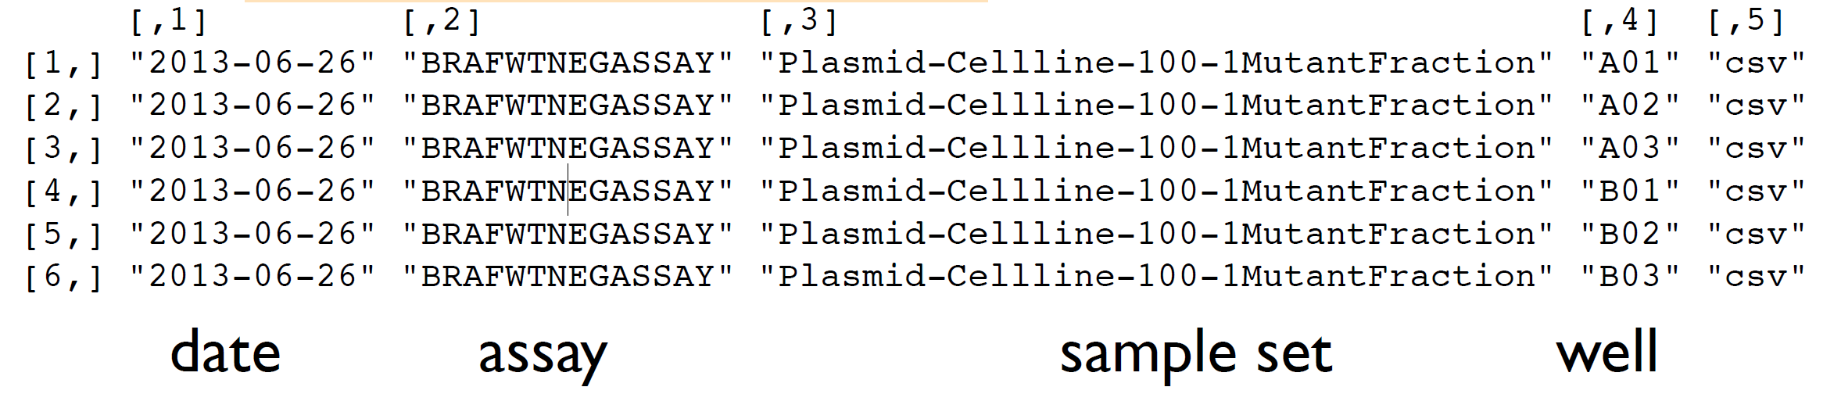
> flist <- list.files(pattern = "Plasmid") %>% head
> stringr::str_split_fixed(flist, "[_\\.]", 5)

Slide 24
Examples happen to be R but also possible in the shell, Python, etc.
Notes:
*.txt → find all files with names ending in .txt

Slide 25
“_” underscore used to delimit units of meta-data
“-” hyphen used to delimit words so eyes don’t bleed
Notes:
*.txt → find all files with names ending in .txt

Slide 26
machine readable
  easy to search for files later
  easy to narrow file lists based on names
  easy to extract info from file names, e.g. by splitting

Slide 27

machine readable
  new to regular expressions and globbing?
  be kind to yourself and avoid:
    spaces in file names
    punctuation!
    áccëntêd chåráctërs
    different files named “foo” and “Foo”

Slide 28
human readable
  name contains info on content → easy to figure out what the heck something is, based on its name
  connects to concept of a slug from semantic URLs
  CW: slug pictures incoming

Slide 29
slug
  part of a URL that identifies a page in human-readable keywords. Usually the end part of the URL, which can be interpreted as the name of the resource, similar to the basename in a filename or the title of a page. Based on the use of the word slug in news media to indicate a short name given to an article for internal use.
  slug pictures will be showing up, I assure you, just not right right now

Slide 30
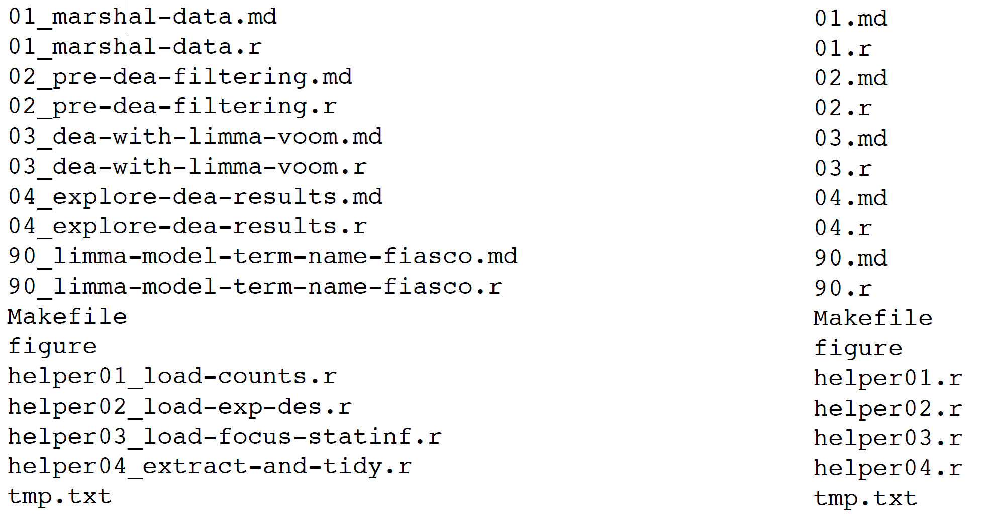
Which set of file(name)s do you want to double check at 2 a.m. before a 6 a.m. deadline when you haven’t worked on the files in over a month or year?
  not right right now, but very soon, I promise

Slide 31
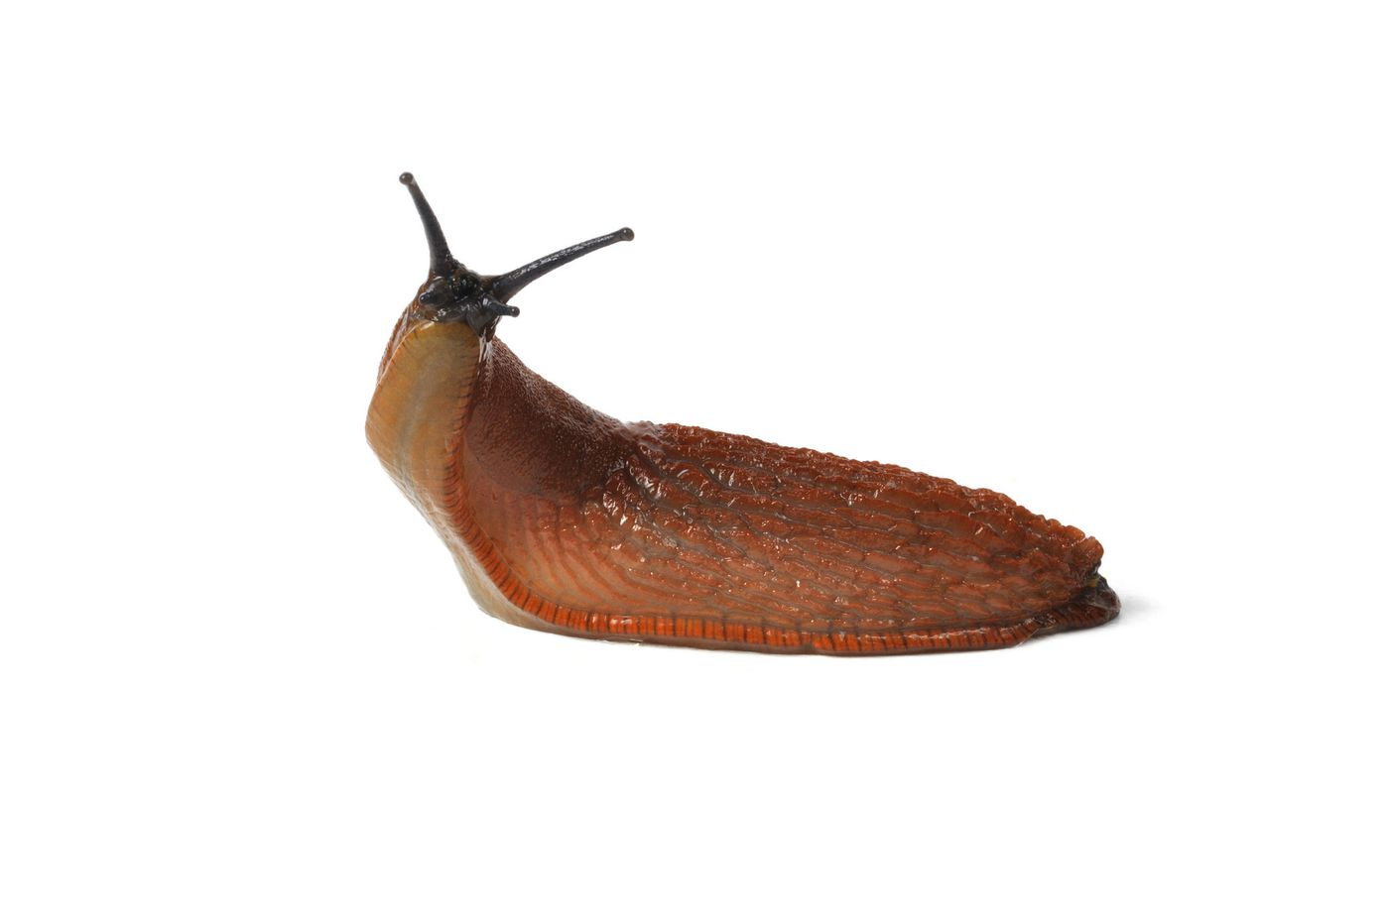
human readable → embrace the slug
  01_marshal-data.r
  02_pre-dea-filtering.r
  03_dea-with-limma-voom.r
  04_explore-dea-results.r
  90_limma-model-term-name-fiasco.r
  helper01_load-counts.r
  helper02_load-exp-des.r
  helper03_load-focus-statinf.r
  helper04_extract-and-tidy.r
  I did warn you, like multiple times, so if you’re grossed out, you really have no one to blame but yourself at this point

Slide 32
plays well with default ordering
  use the ISO 8601 standard for dates
  left pad other numbers with zeros
  put something numeric first?
  probably the most context dependent
  also, CW: cartoony skulls
  I’m probably a little late with that one

Slide 33
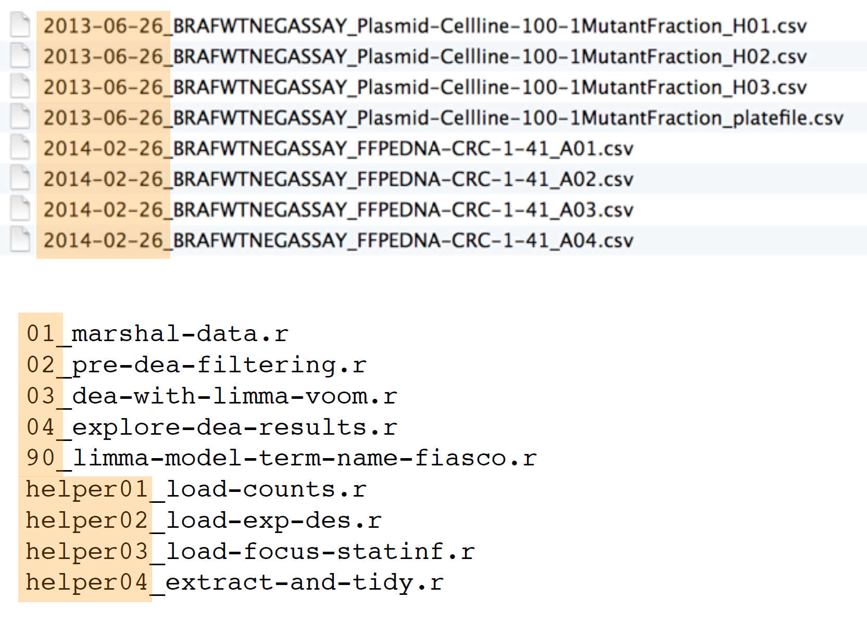
default ordering → logical
  something numeric is (kind of) first

Slide 34
default ordering → chronological
use the ISO 8601 standard for dates: YYYY-MM-DD

Slide 35
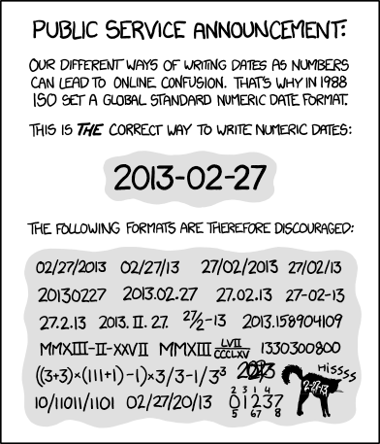
http://xkcd.com/1179/

Slide 36
Comprehensive map of all countries in the
world that use the MM-DD-YYYY format
https://twitter.com/donohoe/status/597876118688026624

Slide 37
default ordering → logical
  left pad other numbers with zeros

Slide 38
Otherwise, thanks to new password sharing policies, you may end up watching all those television shows you “found online” like this…
  E10_Season-Finale-Part-Two_Watching-this-too-early-would-really-ruin-a-ton-of-suprises-that-come-later E1_Pilot_You-need-to-see-this-first-for-everything-else-you-watch-to-make-sense
  E2_Episode-Two_Building-on-stuff-from-the-Pilot
  E3_Episode-Three_Advancing-story-from-Episode-2
  E4_Episode-Four_Advancing-story-from-Episode-3
  E5_Episode-Three_Advancing-story-from-Episode-4
  E6_Episode-Six_Advancing-story-from-Episode-5
  E7_Episode-Seven_Advancing-story-from-Episode-6
  E8_Episodie-Eight_Advancing-story-from-Episode-7
  E9_Season-Finale-Part-One_Watching-this-too-early-would-really-ruin-a-ton-of-suprises-that-come-later
and that means *spoilers*

Slide 39
some final (joel) recommendations

Slide 40
build in flexibility/room to grow
    if you start with…
      01_literature-review
      03_data-sources
      05_analysis
    you can add more later without renaming
      01_literature-review
      02_that-thing-you-found-later
      03_data-sources
      05_analysis

Slide 41
version control on the right
  GOOD
    thing-that-does-the-thing_v01
    thing-that-does-the-thing_v02
    code-to-do-the-other-thing_v01
  NOT GOOD
    v1_thing-that-does-the-thing
    v1_code-to-do-the-other-thing
    v2_thing-that-does-the-thing

Slide 42
three principles for (file) names
  machine readable
  human readable
  plays well with default ordering

Slide 43
three principles for (file) names
  easy to implement NOW
  payoffs accumulate as your skills evolve
  and projects get more complex

Slide 44
coding standards
based on the tidyverse style guide
https://style.tidyverse.org/
by Hadley Wickham

Slide 45
you should read it
so... you basically lifted all this information from other people?
good question, metacommentary text, and the truth is, if there’s good stuff out there already, then we might as well use that
now never question my methods again or from here on out you’re all wingdings

Slide 46
we‘re going to highlight some stuff
as it relates to naming things
but there’s more stuff in
there you should know
what did I tell you?!

Slide 47
Hadley’s welcome
  “Good coding style is like correct punctuation: you can manage without it, butitsuremakesthingseasiertoread…
  All style guides are fundamentally opinionated. Some decisions genuinely do make code easier to use (especially matching indenting to programming structure), but many decisions are arbitrary. The most important thing about a style guide is that it provides consistency, making code easier to write because you need to make fewer decisions.”
  emphasis added to add emphasis

Slide 48
1 Files
  1.1. Names → Similar advice to what we already covered
    Be meaningful
    Avoid non-alphanumeric characters
    Lead with numbers, pad with zero
    Pay attention to capitalization

Slide 49
1 Files
  1.1. Names
    If you make a mistake, don’t give into temptation to use 02a, 02b, etc.
    “Bite the bullet” → rename all files
    it’s a little tough love from Hadley as long as we’re throwing in the kitchen sink of colloquialisms

Slide 50
1 Files
  1.2. Organisation: “It’s hard to describe exactly how you should organise your code across multiple files. I think the best rule of thumb is that if you can give a file a concise name that still evokes its contents, you’ve arrived at a good organisation. But getting to that point is hard.”
  this also applies to how you organize things

Slide 51
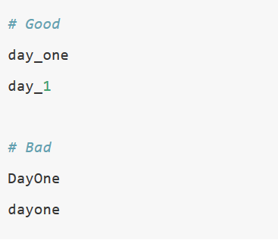
2 Syntax
  2.1 Object names
    Variable and function names should use only lowercase letters, numbers, and _.
    Use underscores (_) to separate words within a name.

Slide 52
2 Syntax
  2.1 Object names
    If you find yourself attempting to cram data into variable names (e.g. model_2018, model_2019), consider using a list or data frame instead.
    Variable names should be nouns
    Function names should be verbs
    Strive to be concise and meaningful

Slide 53
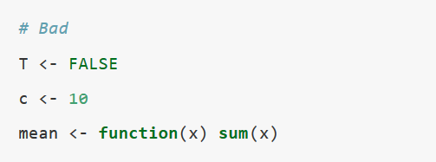
2 Syntax
  2.1 Object names
    Avoid re-using common function and variable names.

Slide 54
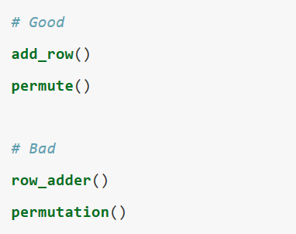
3 Functions
  3.1 Naming
    Follow the general advice for object names (i.e., be concise and meaningful) and use verbs for function names

Slide 55
6 Files (from packages)
    6.1 Names
      If a file contains a single function, give the file the same name as the function.
      If a file contains multiple related functions, give it a concise, but evocative name.

Slide 56
And that’s it
Questions?
I hope this helps and that the commentary wasn’t too distracting…

